Slide 1

IT Application Security - Unit II
- Dr. Gopal Rawat

Slide 2
Background
Almost 90 percent of companies reported that they spend less money on web application security than they spend on coffee: less than $1 per day per employee

Slide 3
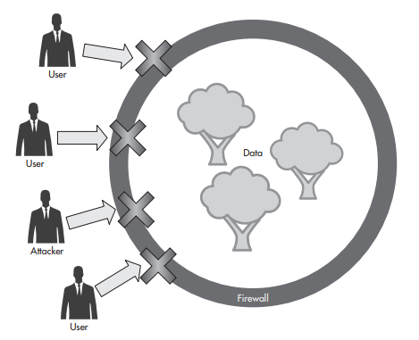
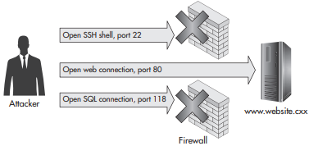
Background

Slide 4
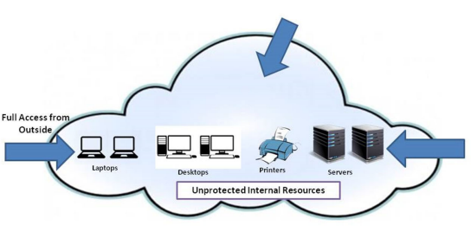
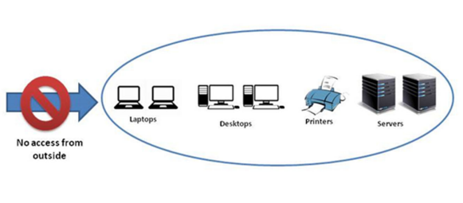
Evolution of Mitigation Technique
Academic security model was “wide open”
Government security model was “closed and locked”

Slide 5
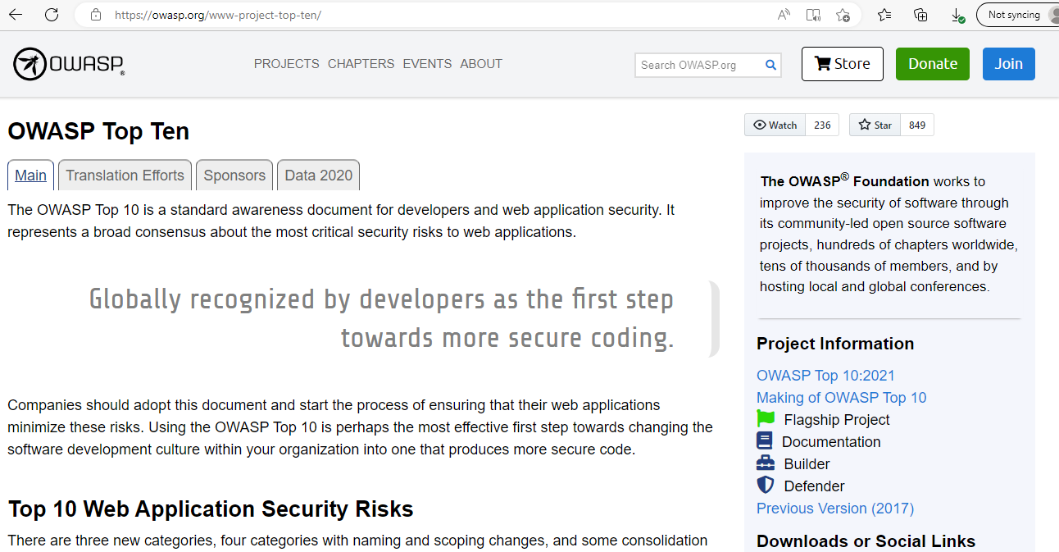
Introduction
“think like an attacker”
Thinking like a Defender
knowing how to defend against specific web application attacks is necessary but not sufficient by itself
The OWASP Top Ten List (Open Web Application Security Project)

Slide 6
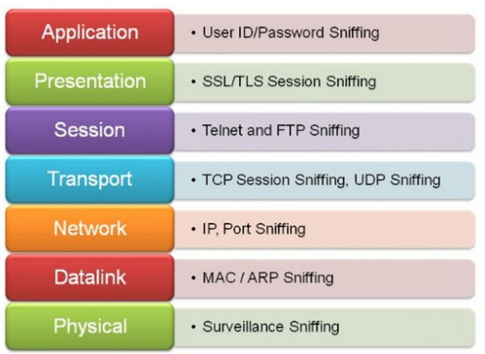
Introduction
Application - Password Exploitation (authentication)
Presentation – Phishing Attack
Session – Session Hijacking / Cookies (authorization)
Transport – SYN Flooding (DOS- DDOS)
Network Layer – Sniffing, IP spoofing
Data link layer – MAC spoofing, ICMP flooding
Physical – Physical attacks on resources

Slide 7
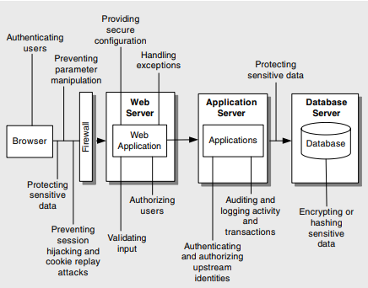
Web Application: Design Issues

Slide 8
Web Application: Design Issues
Vulnerability Category | Potential Problem Due to Bad Design
Input Validation | Attacks performed by embedding malicious strings in query strings, form fields, cookies, and HTTP headers. These include command execution, cross-site scripting (XSS), SQL injection, and buffer overflow attacks.
Sensitive Data | Confidential information disclosure and data tampering
Authentication | Identity spoofing, password cracking, elevation of privileges, and unauthorized access.
Authorization | Access to confidential or restricted data, tampering, and execution of unauthorized operations
Configuration Management | Unauthorized access to administration interfaces, ability to update configuration data, and unauthorized access to user accounts and account profiles

Slide 9
Web Application: Design Issues
Vulnerability Category | Potential Problem Due to Bad Design
Session Management | Capture of session identifiers resulting in session hijacking and identity spoofing
Cryptography | Access to confidential data or account credentials, or both
Parameter Manipulation | Path traversal attacks, command execution, and bypass of access control mechanisms among others, leading to information disclosure, elevation of privileges, and denial of service
Exception Management | Denial of service and disclosure of sensitive system level details.
Auditing and Logging | Failure to spot the signs of intrusion, inability to prove a user’s actions, and difficulties in problem diagnosis.

Slide 10
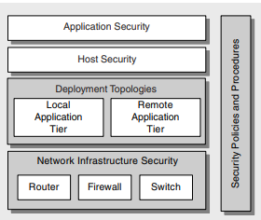
Deployment Considerations

Slide 11
Introduction: Input Validation
Input Validation: Method- Correctness of user’s input data is confirmed prior to sending to server for processing of the requests.
Application developers – input validation attacks
Necessity
rely on web/database apps for information
common to manipulate input

Slide 12
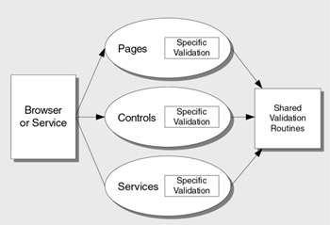
Implementation of Input Validation
The most effective countermeasures of input validation are as follows:
Consider every input to be malicious
Centralize the input validation process
Do not rely on client-side validation
Caution against canonicalization issues

Slide 13
Implementation of Input Validation …
Canonicalization :
c:\temp\somefile.dat
somefile.dat
c:\temp\subdir\..\somefile.dat
c:\ temp\ somefile.dat
..\somefile.dat
c%3A%5Ctemp%5Csubdir%5C%2E%2E%5Csomefile.dat

Slide 14
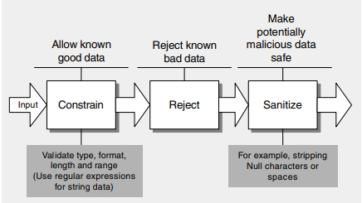
Implementation of Input Validation …
Constrain, Reject, and Sanitize Your Input
Whitelisting
Blacklisting

Slide 15
Implementation of Input Validation …
In practice:
Last Name field
Quantity field
Free-text field
An existing Web application that does not validate user input
- HTML-encoding and URL-encoding user input when writing back to the client
- Rejecting malicious script characters

Slide 16
Input Validation: Attacks
SQL injection
Cross-site scripting
Buffer overflows
Canonicalization

Slide 17
SQL injection
A SQL injection attack exploits vulnerabilities in input validation to run arbitrary commands in the database
-able to retrieve, manipulate, and destroy data
Countermeasures to prevent SQL injection :
Perform thorough input validation
Use parameterized queries
Use least privileged accounts to connect to the database

Slide 18
Input Validation: Cross site scripting (XSS)
XSS
type of injection, in which malicious scripts are injected into otherwise benign and trusted websites
Reflected(non persistent or Type 1) XSS , where the malicious script comes from the current HTTP request.
Stored(persistent or Type 2)XSS, where the malicious script comes from the website's database.
DOM-based XSS (type 0), where the vulnerability exists in client-side code rather than server-side code.
Notes:
DOM is an internal data structure that stores all of the objects and properties of a web page

Slide 19
DOM
Document Object Model (DOM) - programming interface that gives developers the ability to access the document (web page) and manipulate it by executing operations, therefore this interface defines the structure of documents by connecting the scripting language to the actual webpage.
Source : JavaScript property that contains data that an attacker could potentially control:
document.URL
document.referrer
location
location.href
location.search
location.hash
location.pathname
Sink: DOM object or function that allows JS code execution or HTML rendering.
eval setTimeout setInterval document.write element.innerHTML
Notes:
https://brightsec.com/blog/dom-based-xss/

Slide 20
Input Validation: Cross site scripting (XSS) …
XSS for ?
Impersonate or masquerade as the victim user.
Carry out any action that the user is able to perform.
Read any data that the user is able to access.
Capture the user's login credentials.
Perform virtual defacement of the web site.
Inject trojan functionality into the web site.

Slide 21
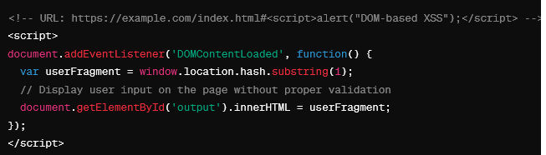
XSS: Scenarios
Search Functionality:
https://example.com/search?query=<script>alert("Reflected XSS");</script>
Comment Section:
<!-- User's comment stored in the database -->
<p>User comment: <script>alert("Stored XSS");</script></p>
Dynamic Update (JS):

Slide 22
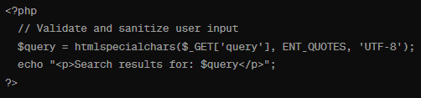
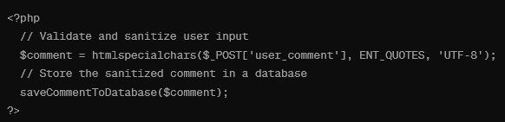
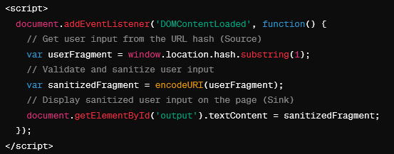
XSS: Scenarios
Solution:
Search Functionality:
https://example.com/search?query=<script>alert("Reflected XSS");</script>
Comment Section:
<!-- User's comment stored in the database -->
<p>User comment: <script>alert("Stored XSS");</script></p>
Dynamic Update (JS):
Solution:

Slide 23
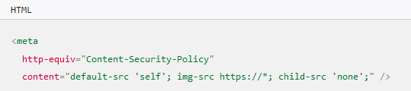
Input Validation: Cross site scripting (XSS) …
Countermeasures :
Perform thorough input validation
Use HTMLEncode and URLEncode functions to encode any output that includes user input.
<script>alert("Hi")</script>
&lt;script&gt;alert(&quot;Hi&quot;)&lt;/script&gt;
http://demo.testfire.net/search.jsp?query=1
http%3A%2F%2Fdemo.testfire.net%2Fsearch.jsp%3Fquery%3D1
Use appropriate response headers (HTTPOnly)
Content Security Policy (browser based)
Content-Security-Policy: default-src 'self'; img-src *; media-src example.org example.net; script-src userscripts.example.com
Content Security Policy (CSP) - HTTP | MDN (mozilla.org)
Notes:
CSP is a browser security mechanism

Slide 24
Input Validation: Buffer overflows
Lead to denial-of-service attacks or code injection
A denial-of-service attack causes a process crash
code injection alters the program execution address to run an attacker’s injected code
Entrance (Trojan Horse/Backdoor)
Smashing the stack – Crash
Running commands
Buffer Overflow (msu.edu)
Buffer overflow attacks in C++: A hands-on guide | Snyk
https://www.youtube.com/watch?v=1S0aBV-Waeo

Slide 25
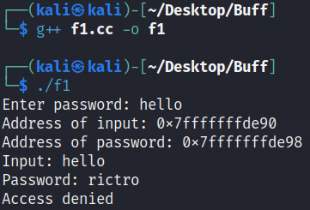
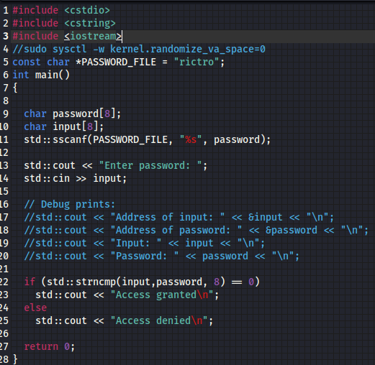
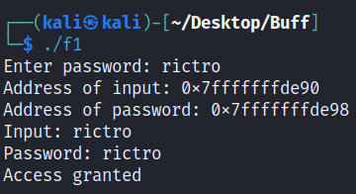
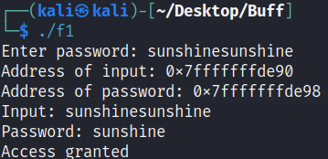
Buffer Overflow: Example
Buffer Overflow

Slide 26
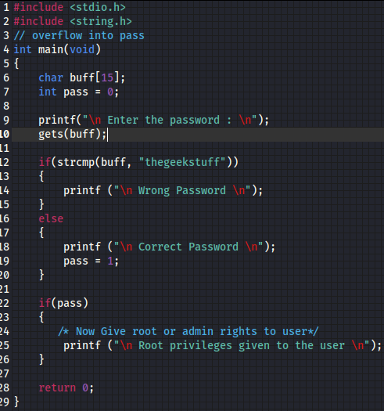
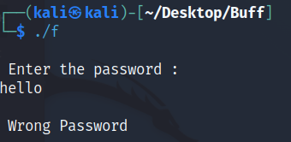
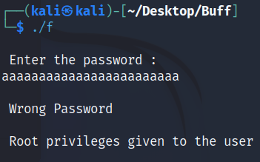
Buffer Overflow: Example2
Buffer Overflow

Slide 27
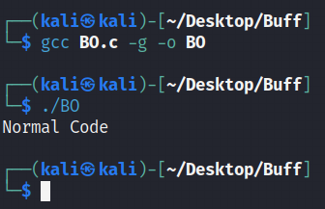
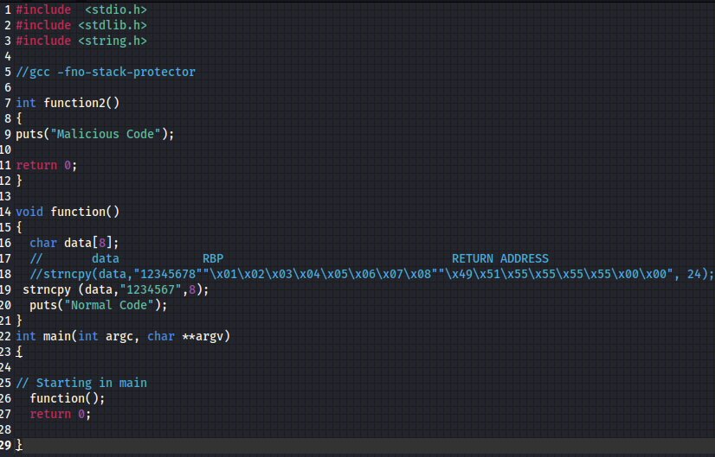
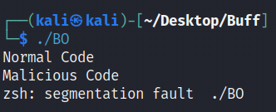
Buffer Overflow: Example 3

Slide 28
Input Validation: Buffer overflows
Countermeasures:
Perform thorough input validation
Inspect the unmanaged APIs to ensure that input is properly validated
Inspect the managed code that calls the unmanaged API
Follow latest bug reports
Check for buffer overflow using web app scanners

Slide 29
Input Validation: Buffer overflows
Countermeasures
Developer approaches:
• Use of safer functions like strncpy(), strncat() etc, safer dynamic link
libraries that check the length of the data before copying.
OS approaches:
• ASLR (Address Space Layout Randomization)
Compiler approaches:
• Stack-Guard
Hardware approaches:
• Non-Executable Stack

Slide 30
Canonicalization
Different forms of input that resolve to the same standard name
Files, paths, and URLs are resource types that are vulnerable
Countermeasures to address canonicalization issues
Avoid input file names where possible and instead use absolute file path
Make sure that file names are well formed (if you must accept file names as input) and validate them
Ensure that the character encoding is set correctly to limit how input can be represented

Slide 31
Sensitive Data
Personal
- name, PAN, Aadhaar, DOB, parents' info, address
Financial
- bank details, credit/debit card, internet password, etc
Organizational
-employees, customers, students, patients
Exposed to : Social engineering , phishing and intrusion

Slide 32
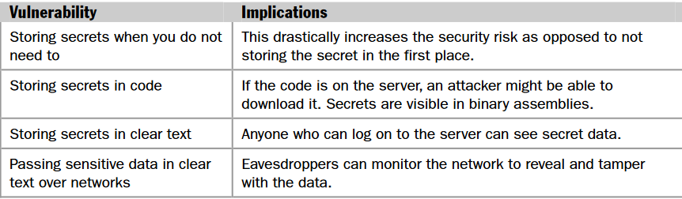
Sensitive Data

Slide 33
Sensitive Data …
Sensitive data exposure – Public and Protected data
Example : Factory reset of mobile
Protection of Sensitive data leakage
-enforce strict data encryption
-use SSL for user authentication
-strong password hashing algorithms
-use penetration testing

Slide 34
Sensitive Data …
Attacks that attempt to view or modify sensitive data can target persistent data stores and networks
Access to sensitive data in storage
Information disclosure
Network eavesdropping
Data tampering

Slide 35
Sensitive Data : Access and Storage
Protection:
Use restricted access control list
Use latest and updated encryption algorithm
Use role based and identity-based authorization to access

Slide 36
Information disclosure
Sensitive data disclosure:
Security flaw
Attack vectors
Threat agents
Impact :
Business
Technical

Slide 37
Information disclosure…
Safeguard sensitive data:
Never store data in clear text ( in backup as well) for long
Never transmit data in clear text (internally or externally)
Use advanced and latest cryptographic algo to encrypt sensitive data
Use strong crypto keys and key management to prevent data breach
Ensure presence of browser security headers

Slide 38
Data Tampering
Data tampering refers to the unauthorized modification of data, often as it is passed over the network
- hashed message authentication codes (HMACs)
An HMAC provides message integrity in the following way:
The sender uses a shared secret key to create a hash based on the message payload.
The sender transmits the hash along with the message payload.
The receiver uses the shared key to recalculate the hash based on the received message payload.
The receiver then compares the new hash value with the transmitted hash value.
If they are the same, the message cannot have been tampered with.

Slide 39
Data Tampering…
Data Tampering protection in URL
input validation
Data Tampering protection in database
- use randomly generated unique identifier
Data Tampering protection using hashing
Data Tampering protection using encryption

Slide 40
Class Test
(a) Explain Cross Site Request Forgery (CSRF) with an example.
(b) List impact and countermeasures.
(c) Compare and Contrast XSS and CSRF.
You may use OWASP, CWE, CVE.

